Slide 1
International Consultants Ltd.
A Risk-Based Approach to Name Screening
© Vigilo International Consultants Ltd. No use or reproduction is allowed without permission

Slide 2
Introduction
International Consultants Ltd.
All banks* use automated engines to undertake their name screening obligations as part of their ongoing KYC/CDD process. Many are also facing problems in managing the risks associated due to the high number of alerts being generated and the number of operations resources required to investigate and manage the output.
To date, the most common methodology is to screen as many lists as deemed necessary by the bank’s risk appetite against the bank’s entire customer database and manually work the hits/alerts generated, with tuning capabilities to suppress or ‘auto close’ obvious false-positives.
This is costly and carries the risk that true matches may not be discovered in a timely manner or that tuning rules may inadvertently suppress true matches.
Although each bank has a unique set of circumstances and clientele, this risk and operational impact could be significantly reduced by creating a risk-based approach to the end-to-end name screening process.
It should also be noted that, from experience, implementing a new name screening solution can discover many long-standing issues elsewhere within the organisation that may need remediation before/during the project.
*This document is applicable to all Financial Institutions, but “Bank” is used for presentation purposes
Although focused on name screening, other data elements can also be included in scope, such as country, address, passport, national ID, etc.
© Vigilo International Consultants Ltd. No use or reproduction is allowed without permission

Slide 3
Scope
International Consultants Ltd.
In a typical implementation of any Name Screening solution there are 6 inter-dependent and parallel workstreams that build the full end-to-end solution.
Normally, the main focus of delivery is on 1 and 5, however in a risk-based approach we review the entire end-to-end process in order to optimise results.
6. Governance & Controls
5. Infrastructure and Technology
5. Infrastructure and Technology
1. System Configuration and Workflows
2. Data
3. List Management
4. Tuning
© Vigilo International Consultants Ltd. No use or reproduction is allowed without permission

Slide 4
System Configuration and Workflows
International Consultants Ltd.
The solution is divided between effectiveness and efficiency:
Effectiveness: Ensuring that that system generates the correct hits according to the bank’s risk appetite
It doesn’t matter how efficient the system is if it’s not effective!
Separate Algorithms per screening context
Separate File Format per screening context (e.g. use of DoB; severity setting; screenable fields; etc.)
Efficiency: The elimination of as many unnecessary hits as possible through configuration and to ensure that processing is optimised
Screening Contexts in order to define separate risk appetites (e.g. Sanctions ≠ PEP)
Organisational Units
Transitions/Workflow
Interaction with Case Management solution/s
© Vigilo International Consultants Ltd. No use or reproduction is allowed without permission

Slide 5
Data
International Consultants Ltd.
This is the bank’s data that is to be screened and must be complete with guaranteed integrity – i.e. there cannot be any loss of data or manipulation between the bank’s systems and the ingestion to screening solution
Data Quality controls to ensure minimum standards
Implementation of minimum standards per screening context
Mapping to file format
Separate names/addresses in ETL layer
Risk Based approach per screening context
Exclude closed accounts
Exclude dormant account from non-Sanctions screening
Exclude certain types of account or relationships from types of screening – e.g. not all relationships pose a PEP risk
© Vigilo International Consultants Ltd. No use or reproduction is allowed without permission

Slide 6
List Management
International Consultants Ltd.
The list of targets that are to be screened and how they are uploaded and managed
Global v Local list requirements
Active List Management in order to reduce the number of unnecessary hits generated per screening context. This can be done in ETL layer or a separate application.
De-duplication
Weak aliases
Manifest errors
Exclusions
Merging
Origins and Designations
Internal list management
GDPR
Minimum data standards per screening context
Areas for Further Discussion
PEP/SOE Definitions
Scope and content of Adverse Media screening and ‘Sustainability’ lists
Frequency of list updates
Application of local lists
© Vigilo International Consultants Ltd. No use or reproduction is allowed without permission

Slide 7
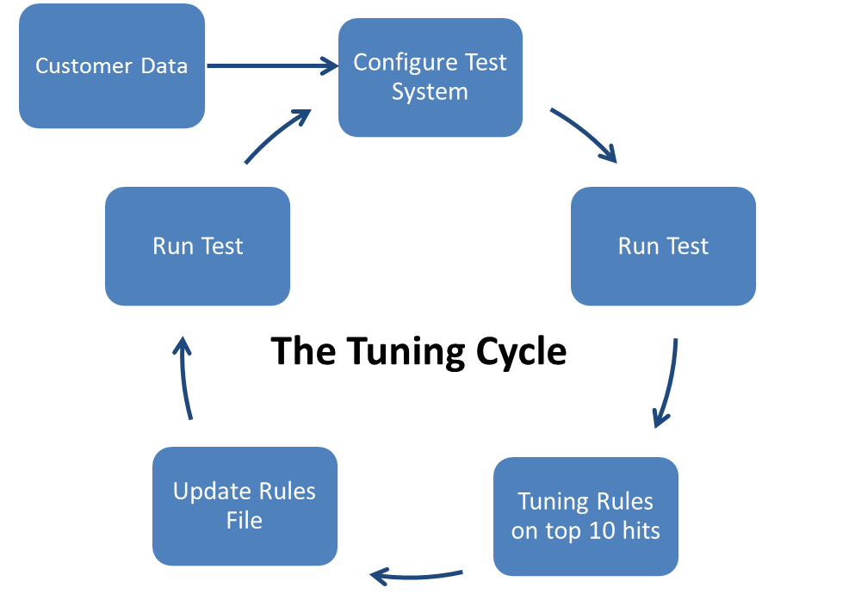
Tuning
International Consultants Ltd.
Tuning is an efficiency task and relates to the “suppression” or “auto-closure” of clear false-positive hits or those that do not meet the risk appetite through the use of rules and/or programs. This also includes the use of ‘noise words’ – i.e. common, generic, words or terms that can create a large number of false-positive matches.
Exclusion rules v Suppression rules
Exclusion rules = rules that can be written before testing starts in order to exclude data (e.g. groups of lists) that does not meet risk appetite and are not required for screening
Suppression rules = false positive hits created that can be suppressed with a rule specific to that hit (e.g. name/gender does not match)
Tuning cycle
The rationale for limiting the tuning for 10 at a time is in order to ensure that full governance and control is completed at each stage and it is much easier to achieve this with smaller volumes. Other automated options are available to meet risk appetite and approach.
© Vigilo International Consultants Ltd. No use or reproduction is allowed without permission

Slide 8
Infrastructure and Technology
International Consultants Ltd.
The hardware and infrastructure binds all other elements together, as well as being important in its own right, as it must be sized and scoped to be able to handle to volume of records, hits, and queries.
Batch v Real-Time approach (also Delta v Full approach)
Physical v Virtual/Cloud-based environments
Outsourced environments (e.g. “cloud” solutions)
Active List Management Application
Support and change control
Availability and integrity
System access
© Vigilo International Consultants Ltd. No use or reproduction is allowed without permission

Slide 9
Governance & Controls
International Consultants Ltd.
Surrounding all of the other streams is the Governance and Control of the end-to-end process, including, but not limited to:
Business requirements gathering – making sure that the solution delivered meets the bank’s specific risk appetite and operational processes
Operational Reporting
Data lineage
Management Information
Risk Appetite
Compliance with policy
Incident Management
Quality Assurance
Liaison with 3 line of defence (Operations/Compliance/Audit)
Communication to external regulators and monitors
Management of 3rd party vendors
Key controls validation (daily/weekly/monthly/annual) – e.g. SIRA
© Vigilo International Consultants Ltd. No use or reproduction is allowed without permission

Slide 10
Implementation Approach
International Consultants Ltd.
Business Requirements
Risk-based design
System Configuration and Workflows
Data
List Management
Tuning
Infrastructure and Technology
Governance & Controls
Planning & Project Management
Training
System configuration
Workflows
Testing
Post-Live support
© Vigilo International Consultants Ltd. No use or reproduction is allowed without permission

